Slide 1
Welcome !!!

Slide 2
A SEMINAR
on
IMAGE SEGMENTATION
….an introductory approach
Presented by
TAWOSE OLAMIDE TIMOTHY
DEPARTMENT OF MATHEMATICAL SCIENCES
(COMPUTER SCINCE OPTION)
CSC 400
Under the Guidance of
Mr. D.O EKONG
Notes:
An holistic,comprehensive,introductory approach

Slide 3
MOTIVATION
Segmentation is difficult
Decades of extensive research, no general “off-the-shelf” solution
Non- uniform illumination
No control of the environment
Inadequate model of the object of interest
Noise
Segmentation on trivial images is one of the difficult task in image processing . Still under research
It has rich mathematical formulations that makes it a worthwhile research topic

Slide 4
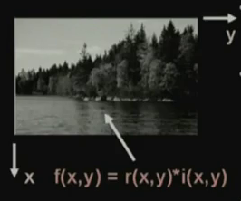
IMAGES:
Image is replica of object.
An image defined in the “real world” is considered as a two dimensional function f(x, y) ,where x and y are spatial coordinates and the amplitude of f at any pair of coordinates (x,y) is called the intensity or gray level of the image at that point.
TYPES OF IMAGES:
-Gray-tone image
-Binary image
Notes:
An image is a 2-D light intensity function f(x,y)
A digital image f(x,y) is discretized both in spatial coordinates and brightness
It can be considered as a matrix whose row, column indices specify a point in the image and the element value identifies gray level at that point
These elements are referred to as pixels or pels

Slide 5
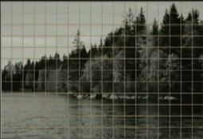
Image representation
Spatial discretization of grids: to obtain sample values at every point.
Intensity discretization by a process called quantization:
representing an image in form of a matrix.

Slide 6
Image representation
I =
f(0,0) f(0,1)…........f(0,N-1)
f(1,0) f(1,1)…........f(1,N-1)
f(2,0) f(2,1)…........f(2,N-1)
f(M-1,0)f(M,1)..f(M-1,N-1)
A matrix of finite dimension , it has m number of rows add n number of columns .
Each of the elements in this matrix representation is called a pixel
Image Size :-256 * 256 elements , 512 * 512, 640 * 480 , 1024 * 1024
Quantization :- 8 bits

Slide 7
Steps in digital image Processing
REPERESENTATION AND DESCRIPTION
RECOGNITION AND INTEPRETATION
IMAGE ACQUISITION
PREPROCESSING
SEGMENTATION
KNOWLEDGE BASE
Problem
Domain
Result
Notes:
Image Acquisition :- An imaging sensor and the capability to digitize the signal produced by the sensor
Preprocessing :- Enhances the image quality, filtering, contrast enhancement etc.
Segmentation :- Partitions an input image into constituent parts of objects
Description / Feature Selection :- Extracts description of image objects suitable for further computer processing.
Recognition and Interpretation :- Assigning a label to the object based on the information provided by its descriptor. Interpretation assigns meaning to a set of labeled objects.
Knowledge Base :- Knowledge Base helps for efficient processing as well as inter module cooperation.

Slide 8
What is Image Segmentation ?
Image segmentation is an aspect of image processing.
Image segmentation is a computer vision process.
Image segmentation is the first step in image analysis.
Input
image
Segmented
objects/image
Object
quantification
Feature
vector
Results
Image segmentation
Annotation of objects
Feature extraction
Classification or cluster
A typical image analysis pipeline.

Slide 9
Image Segmentation Defined
There are many definitions:
In computer vision, Image Segmentation is the process of subdividing a digital image into multiple segments(sets of pixels, also known as superpixels)-Wikipedia,2002
Segmentation is a process of grouping together pixels that have similar attributes-Efford,2000
Image Segmentation is the process of partitioning an image into non-intersecting regions such that each region is homogeneous and the union of no two adjacent regions is homogeneous-Pal,1994
Pixels in a region are similar according to some homogeneity criteria such as colour, intensity or texture so as to locate and identify objects and boundaries (lines,curves,etc) in an image.
The goal of image segmentation is to simplify/change the representation of an image into something that is more meaningful and easier to analyze.

Slide 10
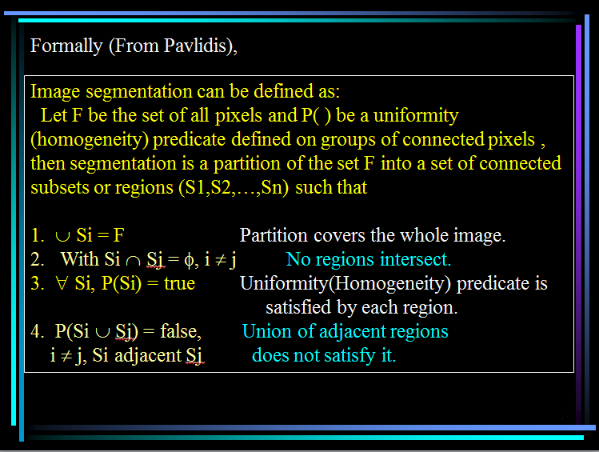



Slide 11
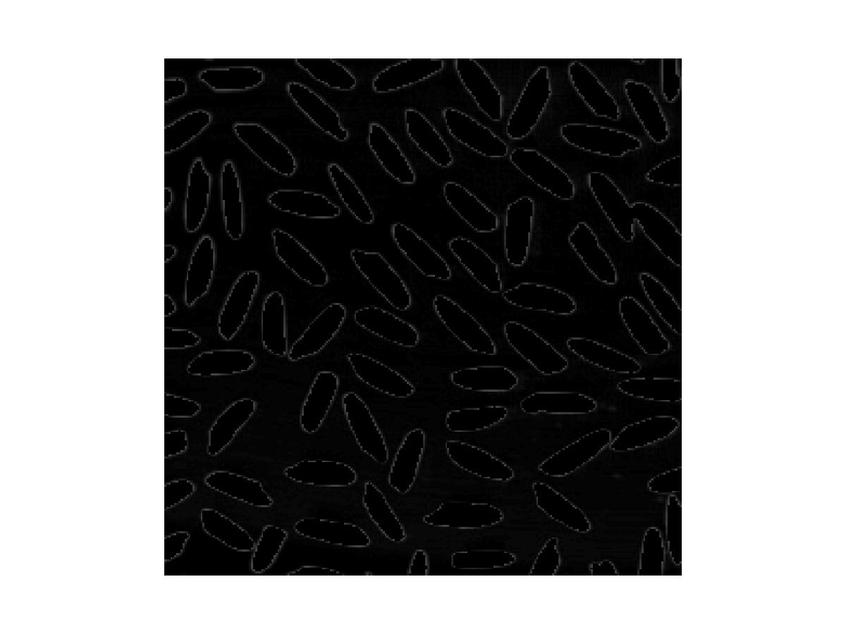
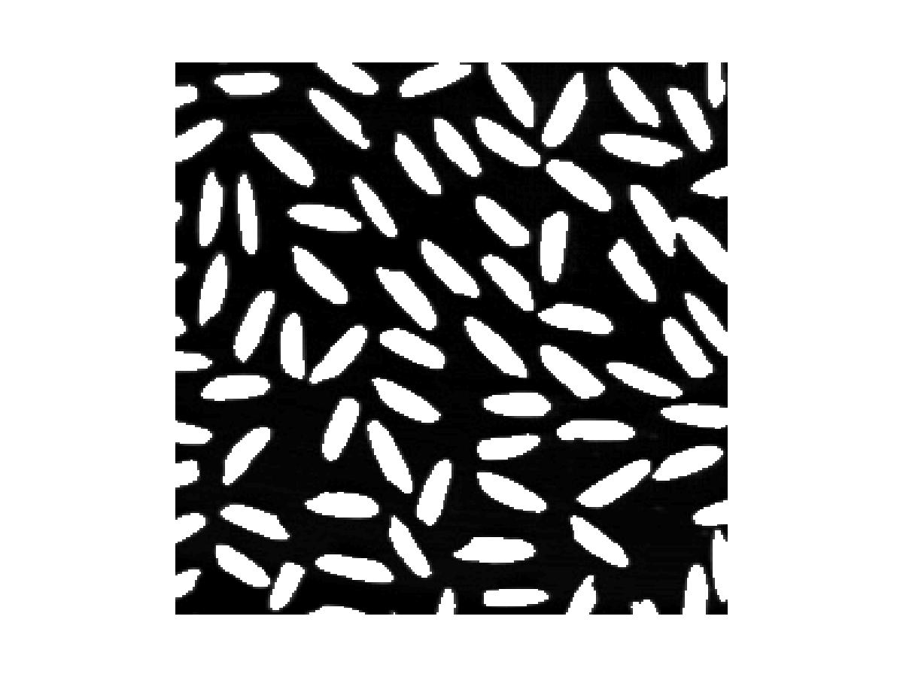
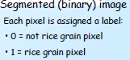
Simple example:

Slide 12
Why segmentation is useful ?
Segmentation accuracy determines the eventual success or failure of computerized analysis procedure.
Improvement of pictorial information for human interpretation/perception
Mapping and Measurement - Automatic analysis of remote sensing data from satellites to identify and measure regions of interest. e.g. Petroleum reserves
It might be possible to analyze the image in the computer and provide cues to the radiologists to help detect important/suspicious structures (e.g.: Computed Aided Diagnosis, CAD)
Notes:
Segmentation algorithms have been used for a variety of applications. Some examples are :
Optical character recognition(OCR)
Automatic Target Acquisition
Colorization of Motion Pictures
Detection and measurement of bone, tissue, etc., in medical images.

Slide 13
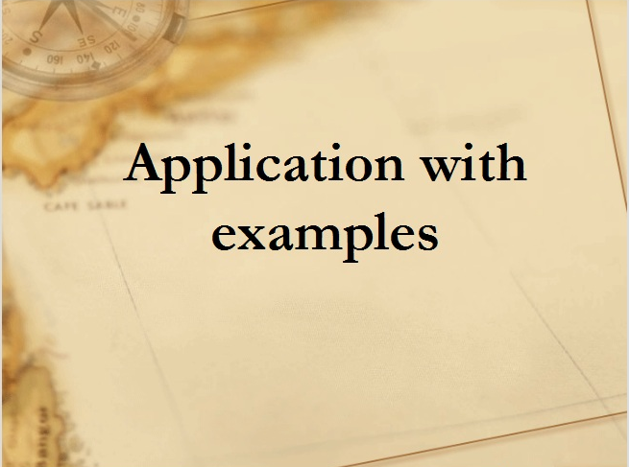

Slide 14
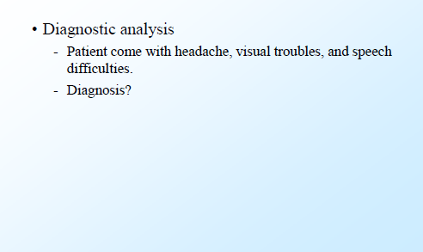
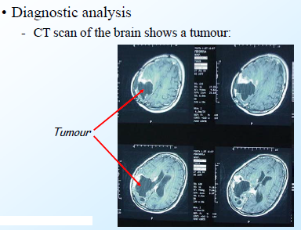
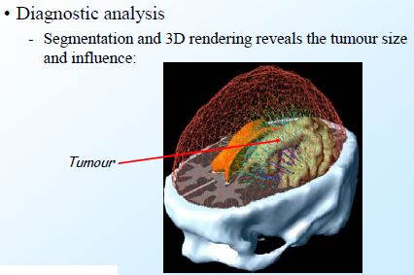
Medical imaging

Slide 15
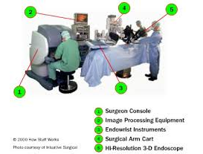
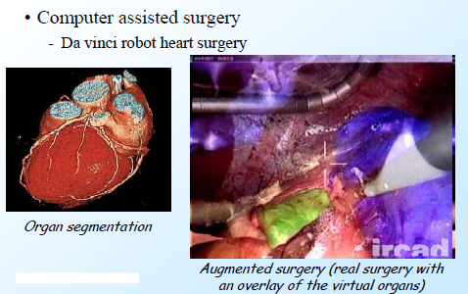
Computer-guided surgery
Da Vinci robot heart surgery
VIDEO DEMO

Slide 16
Object detection
Pedestrian detection
Face detection
Brake light detection
Locate objects in satellite imagery(roads,buildings,forests,etc)
Agricultural imaging-crop disease detection

Slide 17
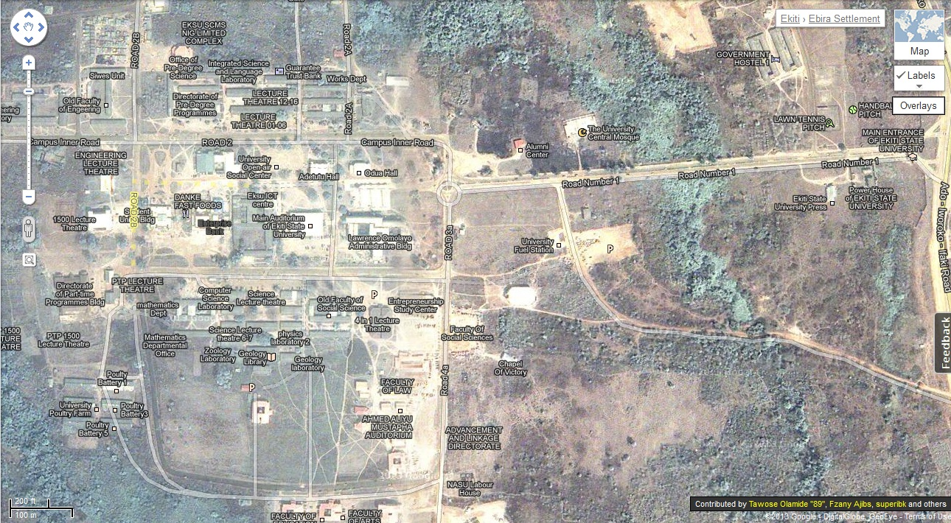
EKSU on Google Maps

Slide 18
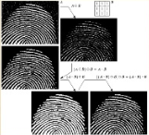
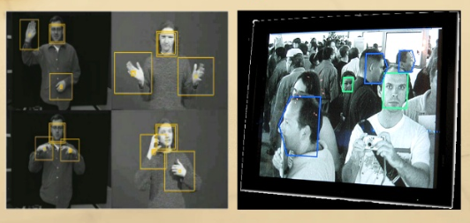
Recognition tasks
Face recognition-g+
Fingerprint recognition
Iris recognition

Slide 19
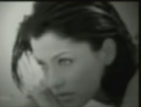
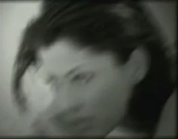

Image deblurring
Defocused
Motion Blurred
Deblurred

Slide 20
Machine Vision Application
Here the interest is on procedures for extraction of image information suitable for computer processing
Typical Applications:-
Industrial Machine Vision for product assembly and inspection.
Automated Target detection and tracking.
Machine processing for aerial and satellite imagery for weather prediction and assessment etc.

Slide 21
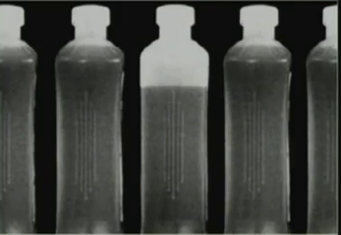
Automated inspection
BOTTLING PLANT AUTOMATION

Slide 22
Other areas of application
Traffic control systems
Content-based image retrieval
Video surveillance
In sport scenes

Slide 23
Image Pre-processing –correcting image defects
Goal of pre-processing
-enhance the visual appearance of images
-improve the manipulation of datasets
Pre-processing
-image resampling
-grayscale contrast enhancement
-noise removal
-Mathematical operations
Notes:
It is sufficient and necessary for an image to undergo pre-processing to correct image defects

Slide 24
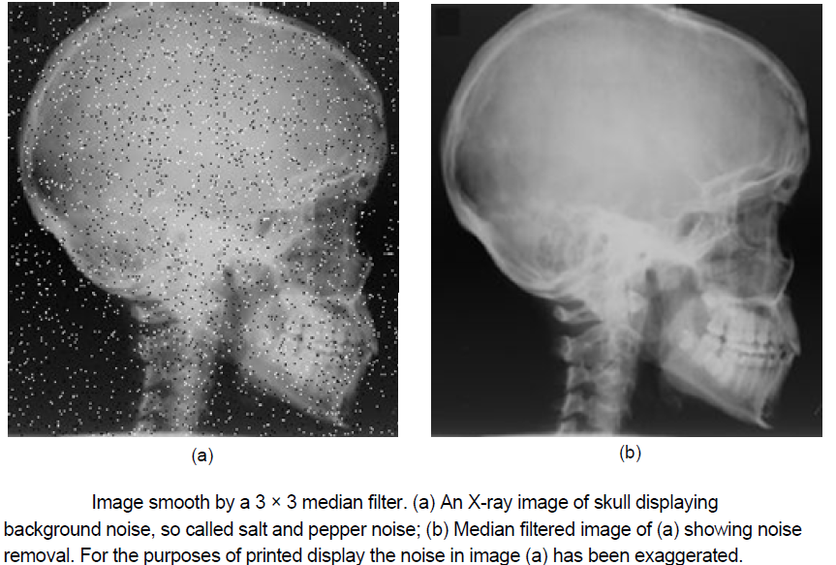
Image smooth by median filter

Slide 25
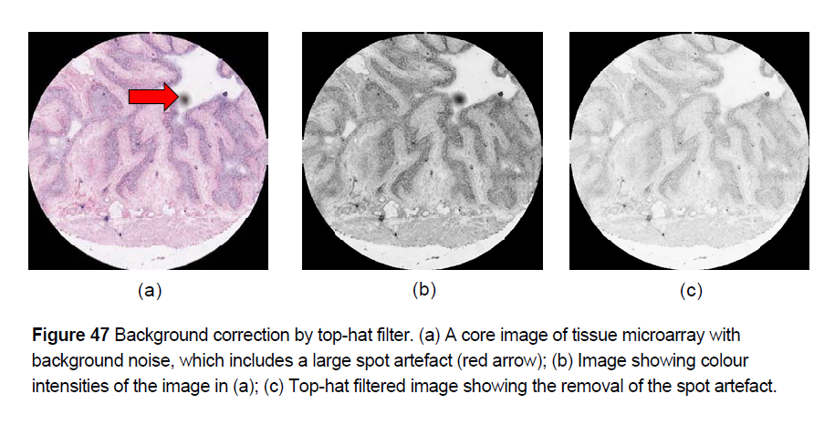
Background correction by Top-hat filter

Slide 26
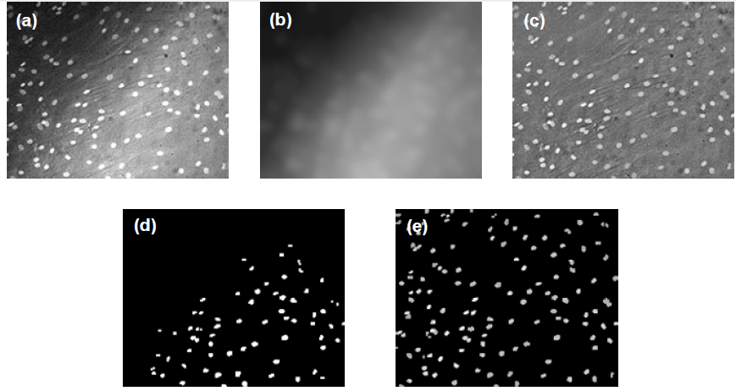
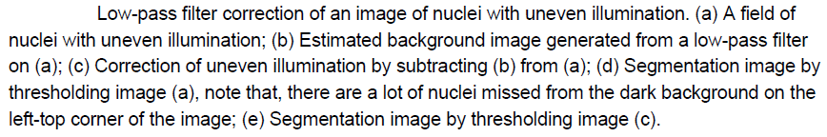
Illumination correction by low-pass filter

Slide 27
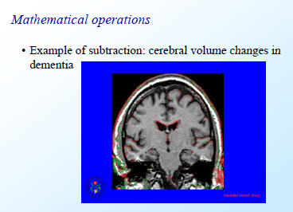
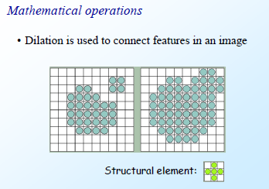
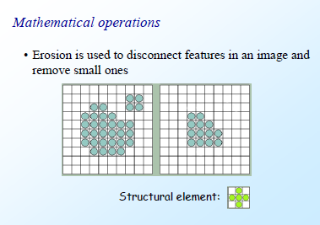

Slide 28
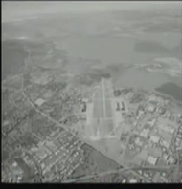
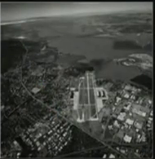
Image Enhancement
Enhanced Image
Low Contrast Image

Slide 29
Principal approaches
Segmentation algorithms generally are based on one of 2 basis properties of intensity values
discontinuity : to partition an image based on sharp changes in intensity (such as edges in an image)
similarity : to partition an image into regions that are similar according to a set of predefined criteria; this includes thresholding,region growing, region splitting and merging.

Slide 30
Detection of Similarities-Thresholding
Thresholding is the simplest, powerful and most frequently/widely used technique for image segmentation
It is useful in discriminating foreground from the background.
Thresholding operation is used to convert a multilevel/gray scale image into binary image
The advantage of obtaining first a binary image is that it reduces the complexity of the data and simplifies the process of recognition and classifiction.
Notes:
Permit me to say threshold works like a compiler.the binary image contain all of the essential information about the position and shape of the objects of interest(foreground)

Slide 31
Thresholding
The most common way to convert a gray-level image into a binary image is to select a single threshold value(T).Then all the gray level values below T will be classified as black(0) i.e. background and those above T will be white(1) i.e. objects.
The Thresholding operation is a grey value remapping operation g defined by:
0 if f(x,y) < T
g(x,y)=
1 if f(x,y) ≥ T,
Where (x,y) represents a gray value/
are the coordinates of the threshold value point
T represent threshold value
g(x,y) represents threshold image
f(x,y) represents gray level image pixels/
input image
Notes:
Thresholding works well when a grey level histogram of the image groups separates the pixels of the object and the background into two dominant modes. Then a threshold T can be easily chosen between the modes.
The threshold operator T,is the widely used image-to-image transformation.it follows that the threshold operator maps any gray-tone image into a binary image.

Slide 32

Background
Object
T
32
Notes:
Histogram are constructed by splitting the range of the data into equal-sized bins (called classes). Then for each bin, the number of points from the data set that fall into each bin are counted.
Vertical axis: Frequency (i.e., counts for each bin)
Horizontal axis: Response variable
In image histograms the pixels form the horizontal axis
In Matlab histograms for images can be constructed using the imhist command.
Horizontal axis: Response variable/pixel intensity
Vertical axis: pixel count

Slide 33
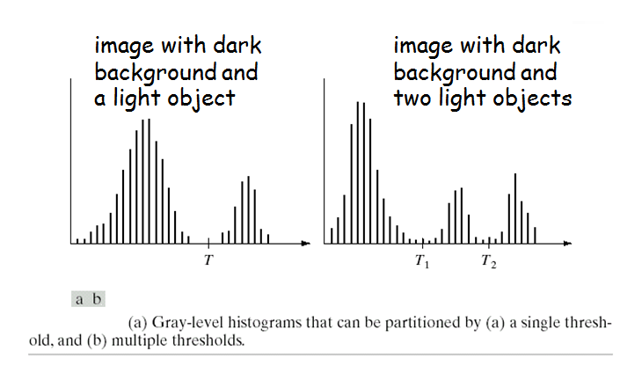
Detection of Similarities-Thresholding
Notes:
Thresholding may be viewed as an operation that involves tests against a function T of the form:
T = T[x,y,p(x,y),f(x,y)]
Where f(x,y) is the gray level , and p(x,y) is some local property.
Simple thresholding schemes compare each pixels gray level with a single global threshold. This is referred to as Global Thresholding.
If T depends on both f(x,y) and p(x,y) then this is referred to a Local Thresholding.
Thresholding is also used to filter the output of or input to other operators. For instance, in the former case, an edge detector like Sobel will highlight regions of the image that have high spatial gradients. If we are only interested in gradients above a certain value (i.e. sharp edges), then thresholding can be used to just select the strongest edges and set everything else to black. As an example,

Slide 34
Thresholding ……/2
Thresholds are either global or local i.e.., they can be constant throughout the image, or spatially varying.
Thresholding methods include:
Conventional thresholding method(supervised process)
Otsu global optimal thresholding method(unsupervised process)
Adaptive local thresholding
Threshold: valley between two adjacent peaks

Slide 35
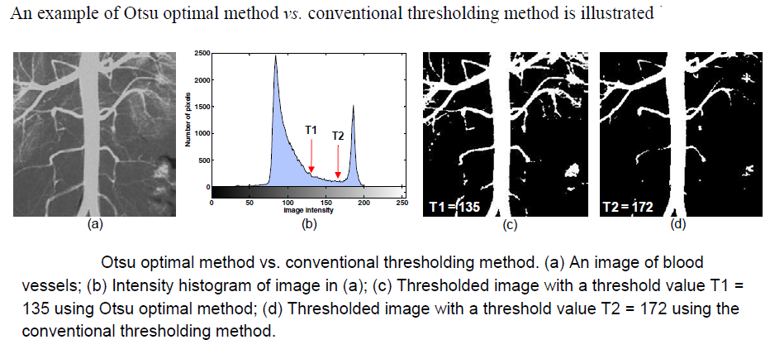

Slide 36
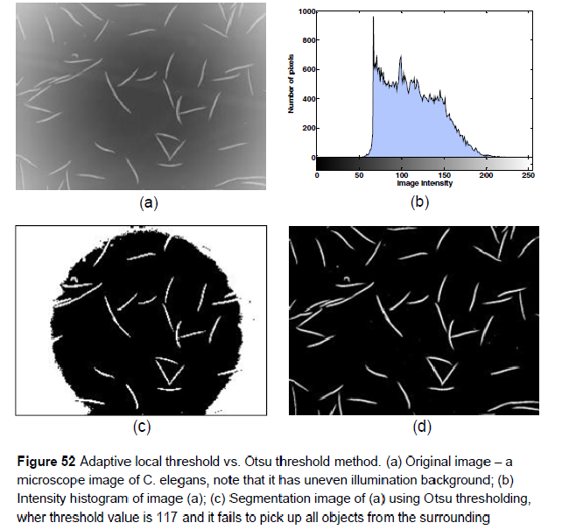

Slide 37
Threshold Selection
Interactive selection of a threshold by the user-possibly with the aid of the image histogram.
Automatic methods: Automatically selected threshold value for each image by the system without human intervention. Automatic methods often make use of the image histogram to find a suitable threshold
Advantages: simple to implement
Disadvantages: It is sensitive to noise
Difficult to set threshold
Notes:
Suppose that the gray-level histogram corresponds to an image, f(x,y), composed of dark objects in a light background, in such a way that object and background pixels have gray levels grouped into two dominant modes. One obvious way to extract the objects from the background is to select a threshold ‘T’ that separates these modes. Then any point (x,y) for which f(x,y) > T is called an object point, otherwise, the point is called a background point.

Slide 38
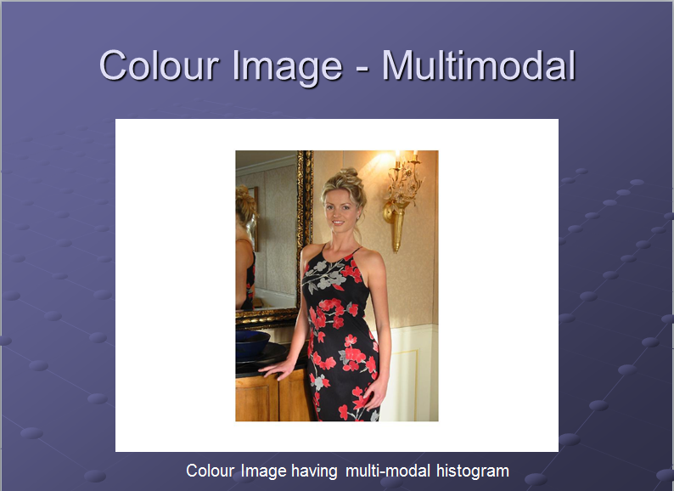
Notes:
Basic Adaptive Thresholding: Images having uneven illumination makes it difficult to segment using histogram, this approach is to divide the original image into sub images and use the above said thresholding process to each of the sub images.

Slide 39
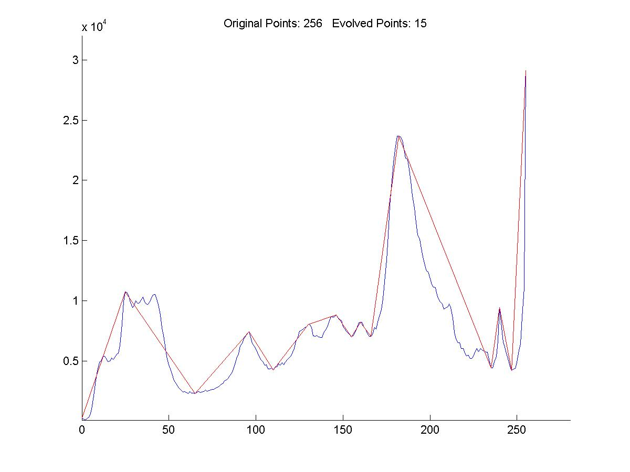
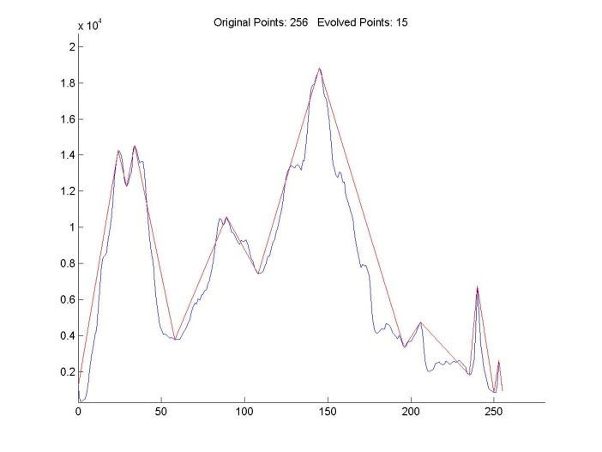
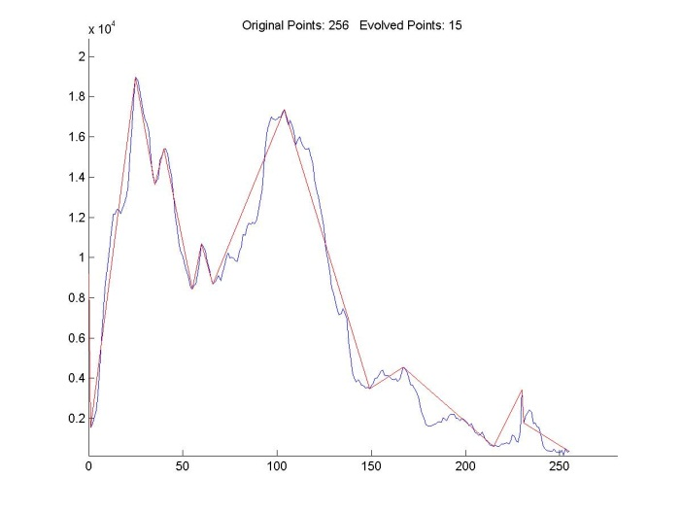
Histogram
Image Histogram for the three color spaces
Notes:
If for example an image is composed of two types of light objects on a dark background, three or more dominant modes characterize the image histogram.
In such a case the histogram has to be partitioned by multiple thresholds.
Multilevel thresholding classifies a point (x,y) as belonging to one object class
if T1 < (x,y) <= T2,
to the other object class
if f(x,y) > T2
and to the background
if f(x,y) <= T1.

Slide 40
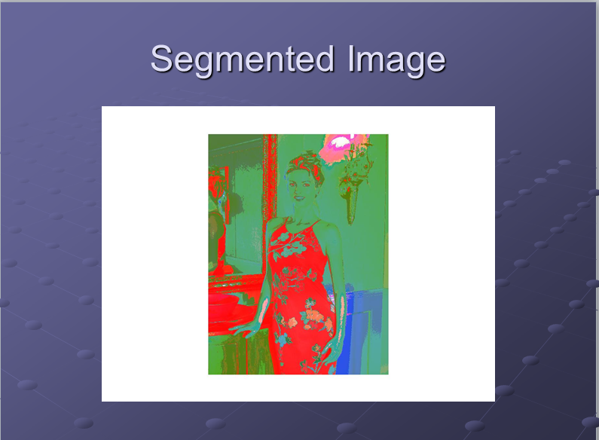

Slide 41
After segmenting the image, the objects can be extracted using edge detection techniques.
Image segmentation techniques are extensively used in Similarity Searches.

Slide 42
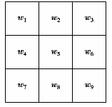
Detection of Discontinuities
detect the three basic types of gray-level discontinuities
points , lines , edges
the common way is to run a mask through the image
Masking: A logical operation carried out on an image in order to modify
or identify a part of it.

Slide 43
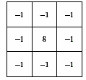
Point Detection
a point has been detected at the location on which the mark is centered if
|R| ≥ T
where
T is a nonnegative threshold
R is the sum of products of the coefficients with the gray levels contained in the region encompassed by the mark.

Slide 44
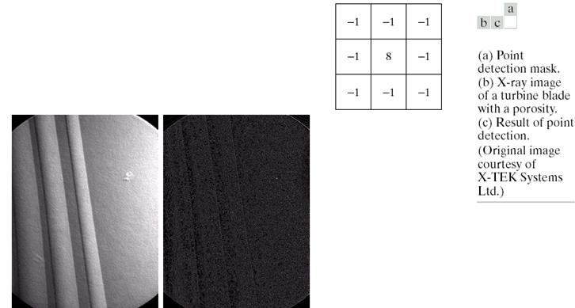
Example

Slide 45
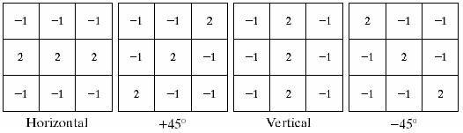
Line Detection
Horizontal mask will result with max response when a line passed through the middle row of the mask with a constant background.
the similar idea is used with other masks.
note: the preferred direction of each mask is weighted with a larger coefficient (i.e.,2) than other possible directions.

Slide 46
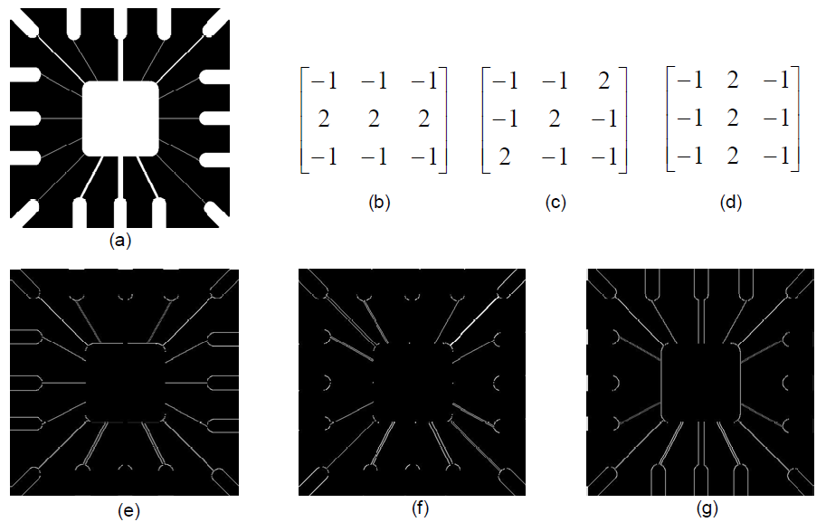
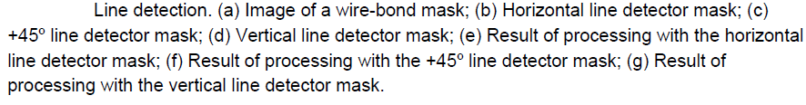
Example

Slide 47
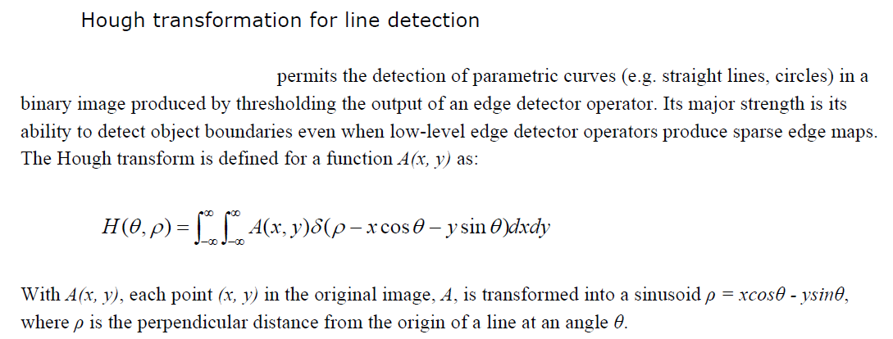

Slide 48
Edge Detection
Edge detection is the name for a set of mathematical methods which aim at identifying points in a digital image at which the image brightness changes sharply or, more formally has discontinuities.
Edge detection is used to obtain information from the frames as a precursor step to feature extraction and object recognition.
This process detects outlines of an object and boundaries between objects and the background in the image
Approaches for implementing
first-order derivative (Gradient operator)
second-order derivative (Laplacian operator)
Edge is the boundary between two homogeneous regions.
Notes:
Edge is the boundary between two homogeneous regions.
The points at which image brightness changes sharply are typically organized into a set of curved line segments termed edges.
Edge detection refers to the process of identifying and locating sharp discontinuities in an image. These methods exploit the fact that the pixel intensity values change rapidly at the boundary(edge) of two regions.

Slide 49
Edge detector
Advantages : easy to implement
simple to understand
Disadvantages: It is not suitable for very noisy images
It is not suitable for edgeless images
It is not suitable for images whose
boundaries are very smooth

Slide 50
Edge filter operators/edge detection techniques
There are seven techniques namely:
-Sobel operator: most useful and widely available edge filters/gradient masks.
-Roberts cross edge operator
-Laplacian operator
-Prewitt operator
-Kiresh operator
-Canny edge detector : most preferred
-Edge maximization technique(EMT)
Notes:
Edge-based approach
Applying edge detector on the image.
Then linking detected edges to generate boundaries.
Makes use of only local information, so difficult to guarantee continuous and closed boundaries.

Slide 51
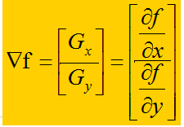
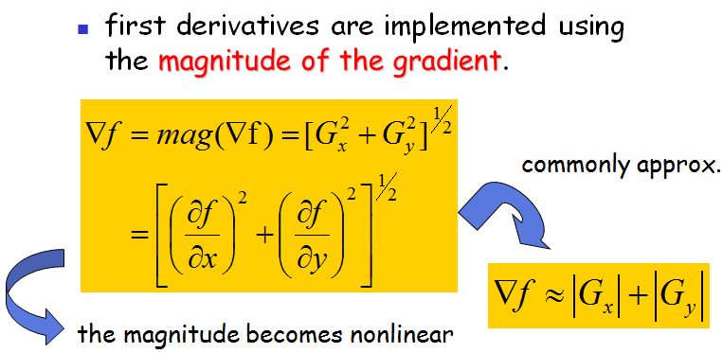
Gradient Operator

Slide 52
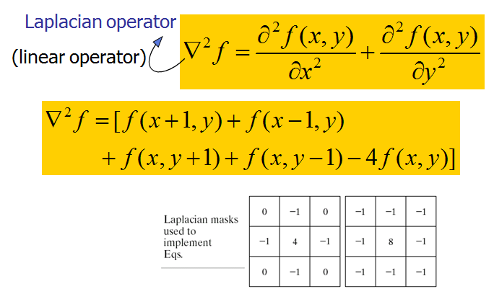
Laplacian

Slide 53
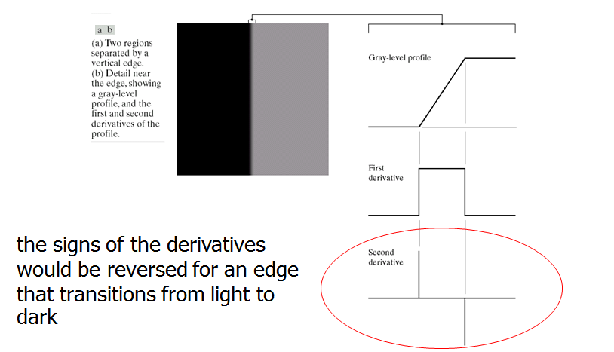
First and Second derivatives

Slide 54
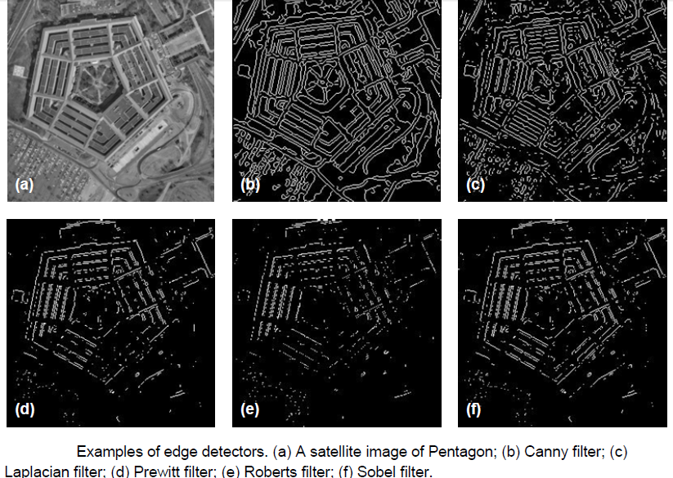
Comparing edge filter operators

Slide 55
Canny Edge Detector
Smooth the image with a Gaussian filter to reduce noise and remove small details.
Compute gradient magnitude and direction at each pixel of the smoothed image.
Non-maximal suppression of smaller gradients by larger ones to focus edge localization
Gradient magnitude thresholding and linking that uses hysteresis so as to start linking at strong edge positions, gut then also track weaker edges.
Notes:
Zero out any pixel response ≤ the two neighboring pixels
on either side of it, along the direction of the gradient.
Track high-magnitude contours.
Keep only pixels along these contours, so weak little
segments go away.

Slide 56
Other segmentation techniques
Region based segmentation methods
Segmentation methods based on PDE
Segmentation based on artificial neural network
Segmentation based on clustering
Segmentation using morphological watersheds
Multiobjective image segmentation

Slide 57

Questions ?
Tawose Olamide Timothy

